Slide 1
Технологии сверхкритических флюидов применительно к созданию наночастиц
Москва, МГУ, Физический Факультет, 2018

Slide 2
Литература к лекции
K. Byrappa b, S. Ohara a, T. Adschiri. Nanoparticles synthesis using supercritical fluid technology – towards biomedical applications. Advanced Drug Delivery Reviews 60 (2008) 299–327
E. Reverchon, R. Adami. Nanomaterials and supercritical fluids. J. of Supercritical Fluids 37 (2006) 1–22
Hiromichi Hayashi and Yukiya Hakuta. Hydrothermal Synthesis of Metal Oxide Nanoparticles in Supercritical Water. Materials 2010, 3, 3794-3817; doi:10.3390/ma3073794

Slide 3
Способы создания наночастиц
static supercritical fluid process (SSF)
rapid expansion of supercritical solutions (RESS)
particles from gas-saturated solutions (PGSS)
gas antisolvent process (GAS)
precipitation from compressed antisolvent (PCA)
aerosol solvent extraction system (ASES)
supercritical antisolvent process (SAS)
solution enhanced dispersion by supercritical fluids (SEDS)
supercritical antisolvent process with enhanced mass transfer (SAS-EM)
depressurization of an expanded liquid organic solution (DELOS)
supercritical assisted atomization (SAA)
hydrothermal synthesis under supercritical conditions via flow reactor (HTSSF)
hydrothermal synthesis under supercritical conditions via batch reactor (HTSSB)
supercritical fluids drying (SCFD)
supercritical fluid extraction emulsions (SFEE)

Slide 4
Способы создания наночастиц
static supercritical fluid process (SSF)
rapid expansion of supercritical solutions (RESS)
particles from gas-saturated solutions (PGSS)
gas antisolvent process (GAS)
precipitation from compressed antisolvent (PCA)
aerosol solvent extraction system (ASES)
supercritical antisolvent process (SAS)
solution enhanced dispersion by supercritical fluids (SEDS)
supercritical antisolvent process with enhanced mass transfer (SAS-EM)
depressurization of an expanded liquid organic solution (DELOS)
supercritical assisted atomization (SAA)
hydrothermal synthesis under supercritical conditions via flow reactor (HTSSF)
hydrothermal synthesis under supercritical conditions via batch reactor (HTSSB)
supercritical fluids drying (SCFD)
supercritical fluid extraction emulsions (SFEE)

Slide 5
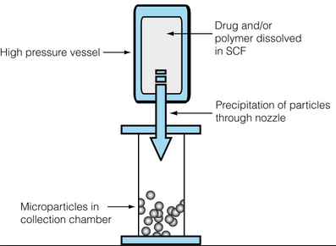
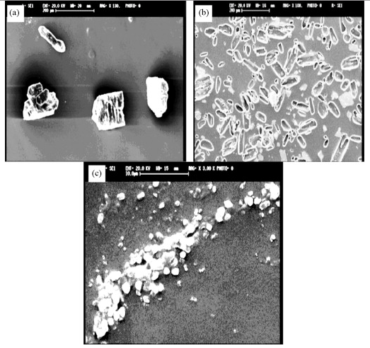
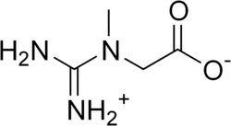
RESS

Slide 6
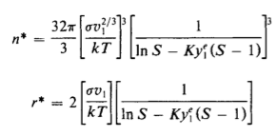
RESS

Slide 7
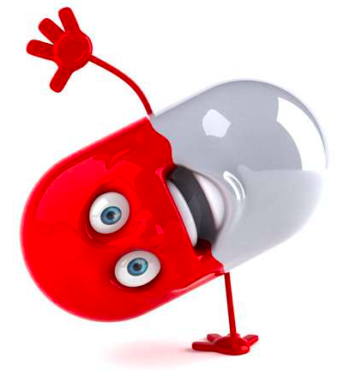
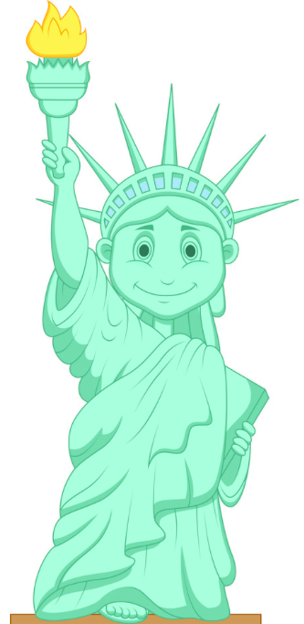
RESS
 | Ткр, С | Ркр, атм
Пропилен | 92 | 46
Пентан | 197 | 34
Пропан | 97 | 42
Хлордифторметан | 96 | 49
Полипропиленовые, полистирольные, полиметилметакрилатные, поликапролактоновые наночастицы
Наночастицы полимеров молочной кислоты, полигликолидные, полисахаридные (HYAFF-11) наночастицы
СК СО₂ + сорастворители (ацетон, этанол)
Покрытия из полидиметилсилоксана, фторакрилатных полимеров, перфторированных полиэфиров
СК СО₂

Slide 8
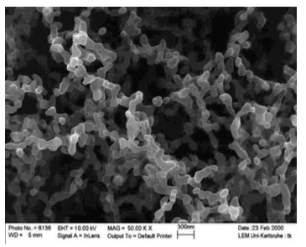
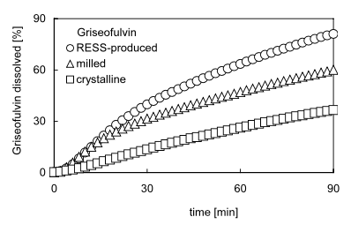
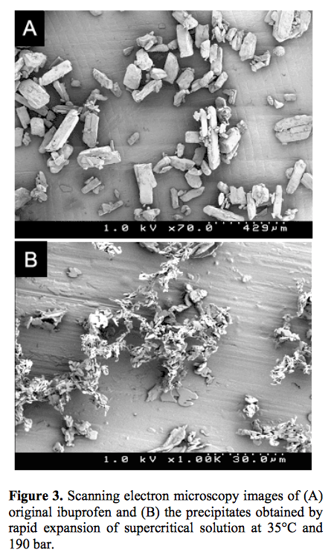
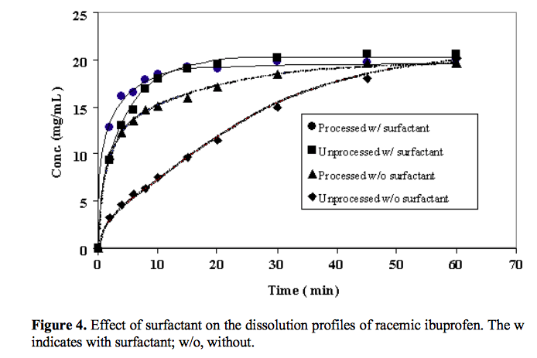
RESS. Увеличение растворимости лекарственных средств.

Slide 9
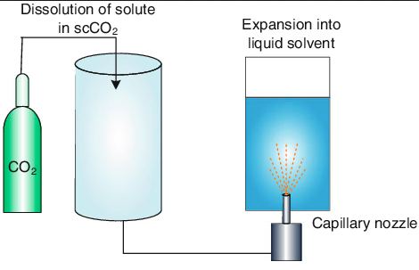
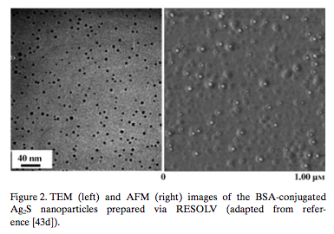
RESOLV/RESAS
Раствор AgNO₃ в сверхкритическом аммиаке -> раствор Na₂S (восстанавливающий агент) + БСА (белок)

Slide 10
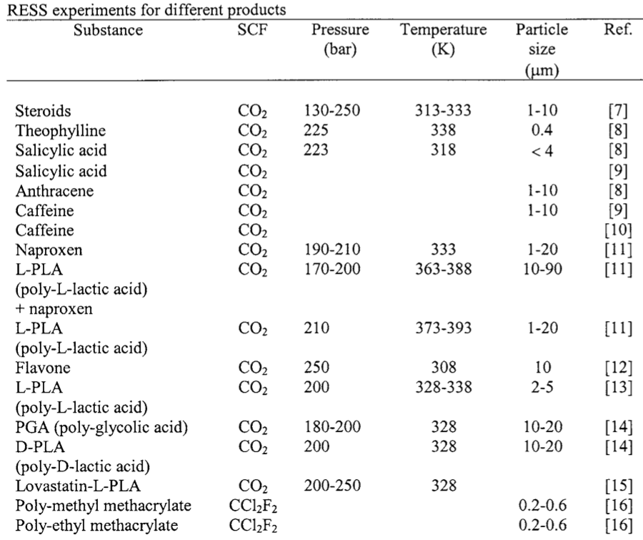
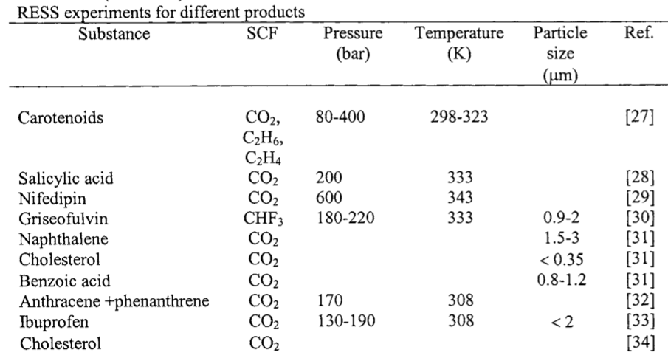
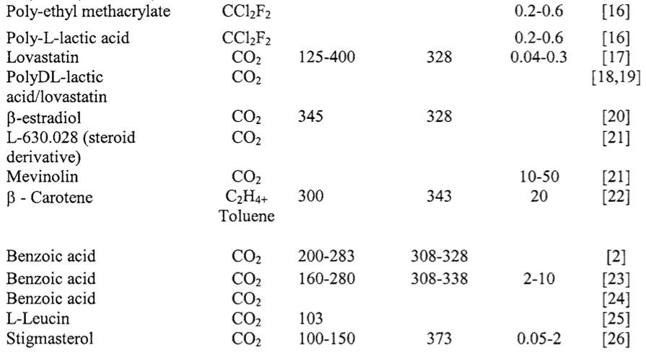
RESS

Slide 11
Способы создания наночастиц
static supercritical fluid process (SSF)
rapid expansion of supercritical solutions (RESS)
particles from gas-saturated solutions (PGSS)
gas antisolvent process (GAS)
precipitation from compressed antisolvent (PCA)
aerosol solvent extraction system (ASES)
supercritical antisolvent process (SAS)
solution enhanced dispersion by supercritical fluids (SEDS)
supercritical antisolvent process with enhanced mass transfer (SAS-EM)
depressurization of an expanded liquid organic solution (DELOS)
supercritical assisted atomization (SAA)
hydrothermal synthesis under supercritical conditions via flow reactor (HTSSF)
hydrothermal synthesis under supercritical conditions via batch reactor (HTSSB)
supercritical fluids drying (SCFD)
supercritical fluid extraction emulsions (SFEE)

Slide 12
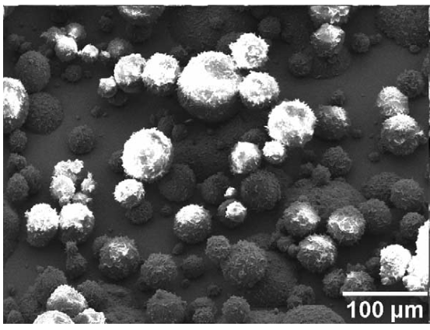
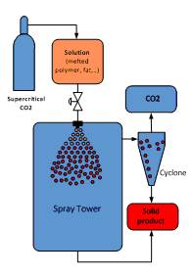
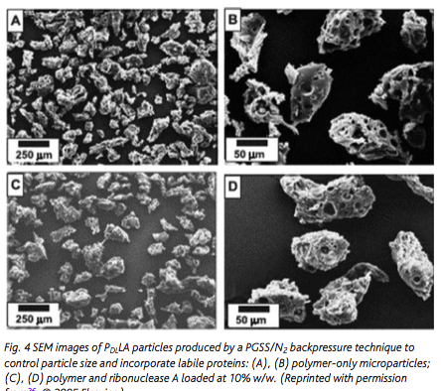
PGSS

Slide 13
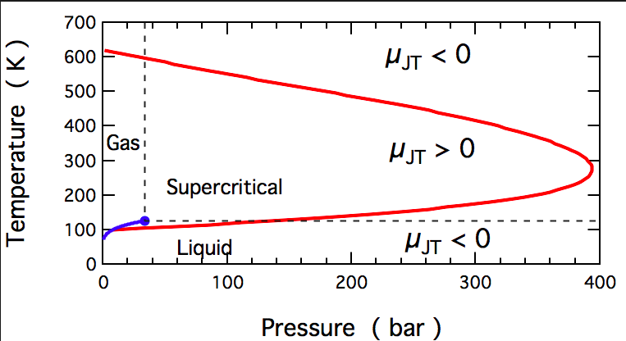
Эффект Джоуля-Томпсона
Для азота

Slide 14
Способы создания наночастиц
static supercritical fluid process (SSF)
rapid expansion of supercritical solutions (RESS)
particles from gas-saturated solutions (PGSS)
gas antisolvent process (GAS)
precipitation from compressed antisolvent (PCA)
aerosol solvent extraction system (ASES)
supercritical antisolvent process (SAS)
solution enhanced dispersion by supercritical fluids (SEDS)
supercritical antisolvent process with enhanced mass transfer (SAS-EM)
depressurization of an expanded liquid organic solution (DELOS)
supercritical assisted atomization (SAA)
hydrothermal synthesis under supercritical conditions via flow reactor (HTSSF)
hydrothermal synthesis under supercritical conditions via batch reactor (HTSSB)
supercritical fluids drying (SCFD)
supercritical fluid extraction emulsions (SFEE)

Slide 15
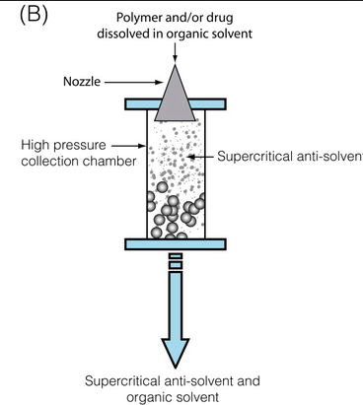
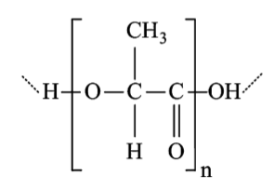
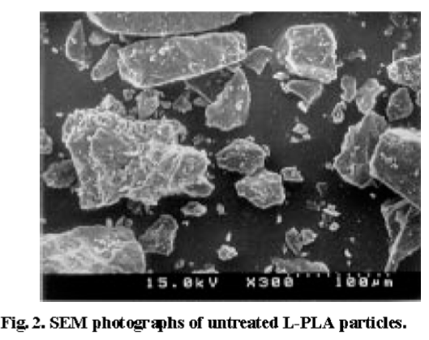
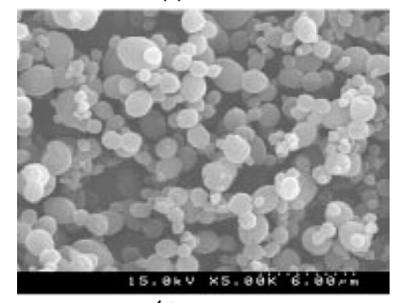
ASES

Slide 16
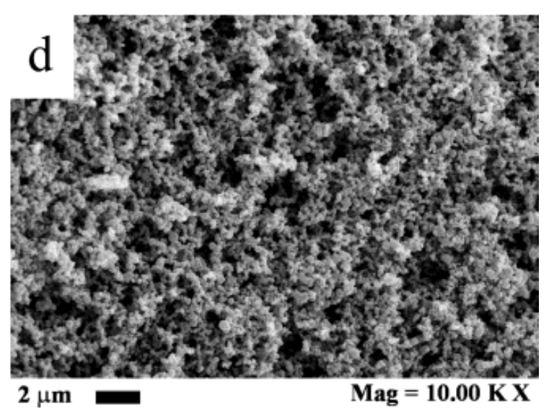
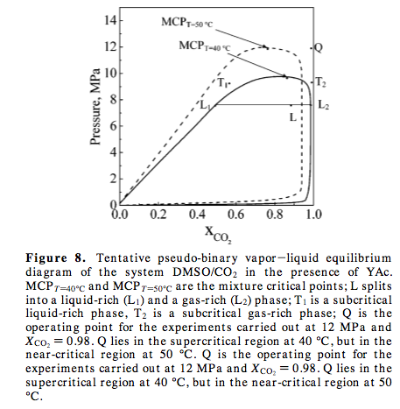
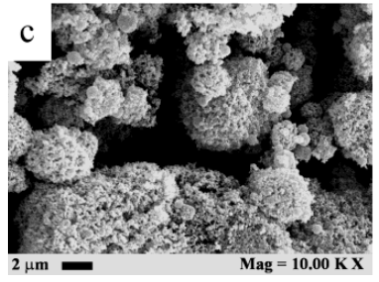
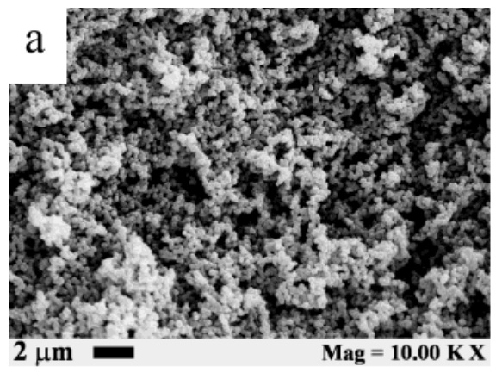
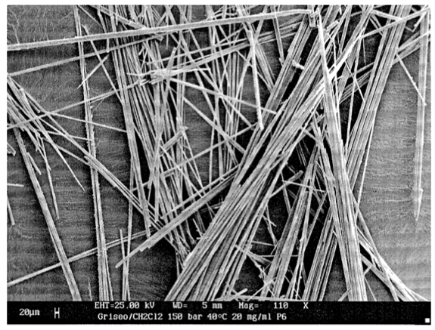
SAS, принципы
1 фаза, СК
1 фаза, субкритика
2 фазы

Slide 17
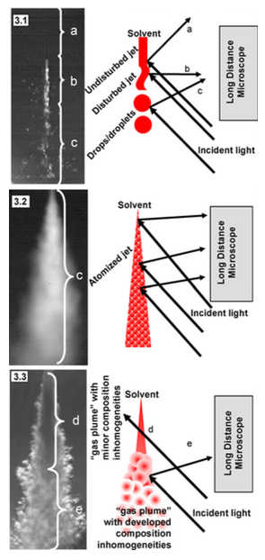
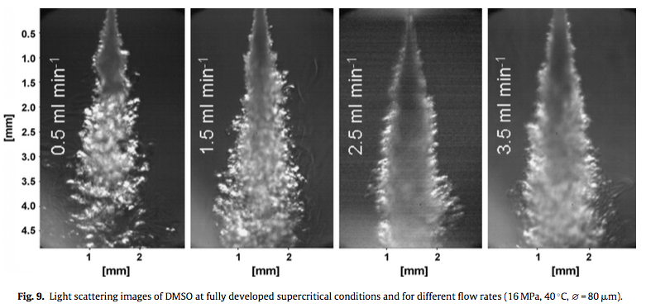
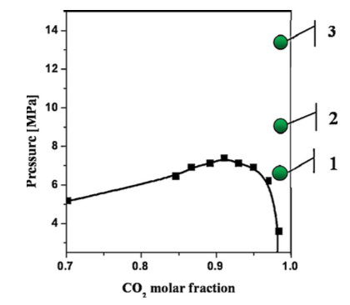
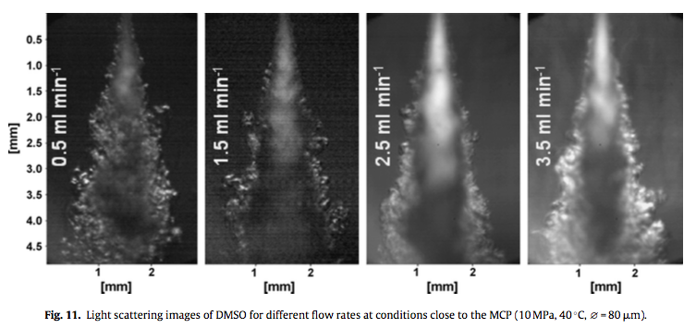
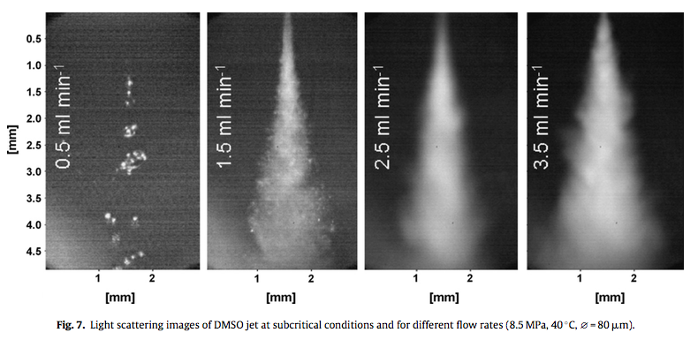
SAS, принципы
СК, далеко от кр. т.
СК, близко к кр. т.
Субкритика

Slide 18
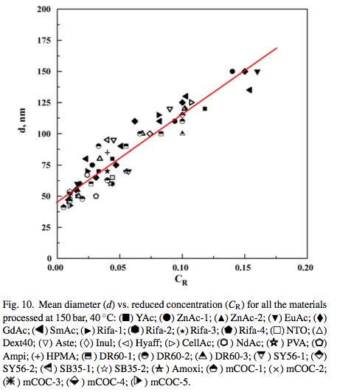
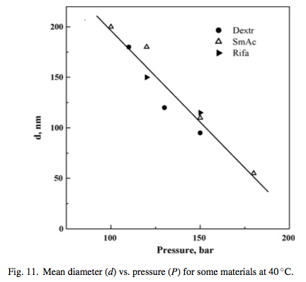
SAS, принципы

Slide 19
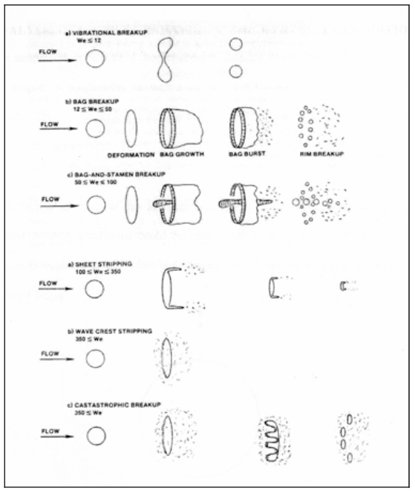
SAS, принципы
Регион вблизи и ниже критической точки смеси: механизм одна капля-одна частица.
Сверхкритический регион: механизм осаждение из газа в частицу.
Нулевая сила поверхностного натяжения.

Slide 20
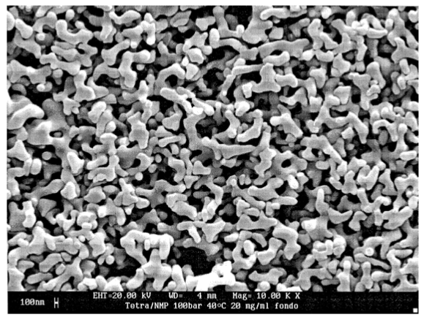
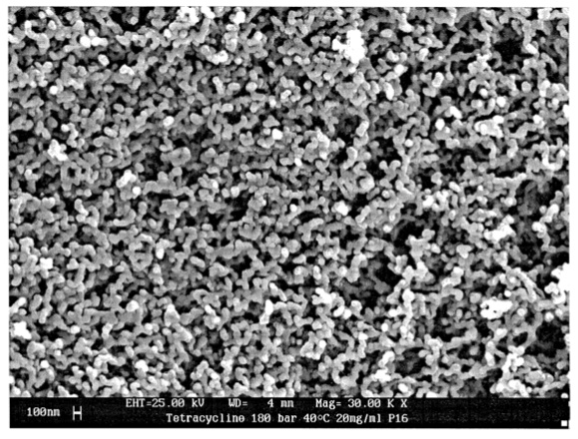
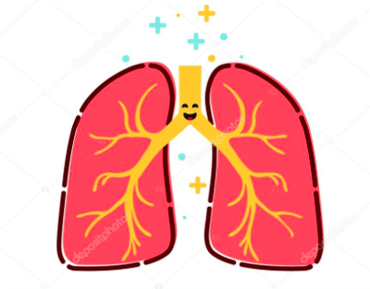
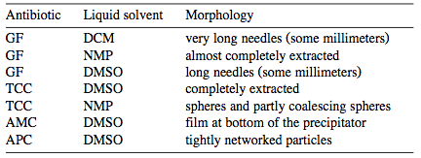
SAS
Тетрациклин в N-метил-2-пирролидоне
100 атм
180 атм
Частицы < 5 мкм

Slide 21
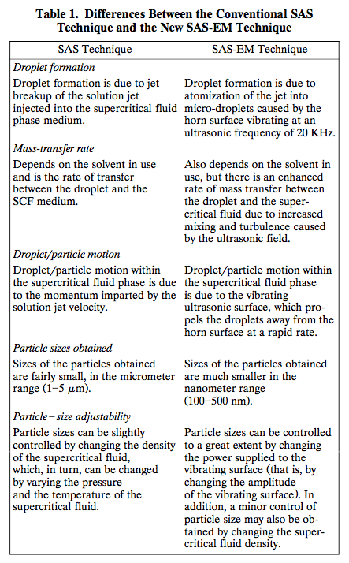
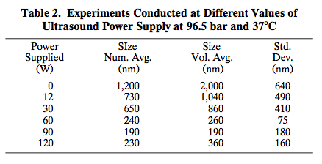
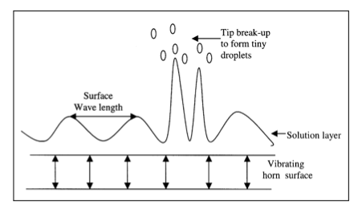
SAS-EM

Slide 22
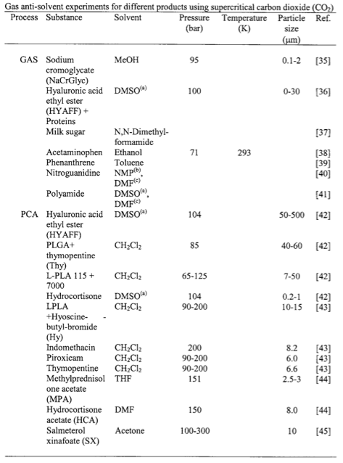
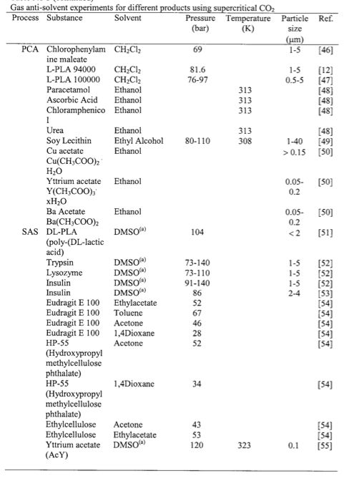
Anti-solvent

Slide 23
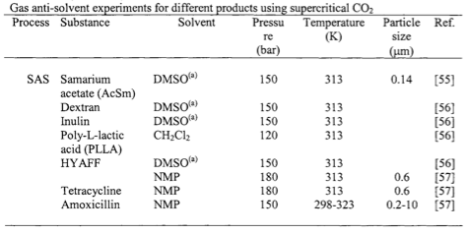
Anti-solvent

Slide 24
Способы создания наночастиц
static supercritical fluid process (SSF)
rapid expansion of supercritical solutions (RESS)
particles from gas-saturated solutions (PGSS)
gas antisolvent process (GAS)
precipitation from compressed antisolvent (PCA)
aerosol solvent extraction system (ASES)
supercritical antisolvent process (SAS)
solution enhanced dispersion by supercritical fluids (SEDS)
supercritical antisolvent process with enhanced mass transfer (SAS-EM)
depressurization of an expanded liquid organic solution (DELOS)
supercritical assisted atomization (SAA)
hydrothermal synthesis under supercritical conditions via flow reactor (HTSSF)
hydrothermal synthesis under supercritical conditions via batch reactor (HTSSB)
supercritical fluids drying (SCFD)
supercritical fluid extraction emulsions (SFEE)

Slide 25
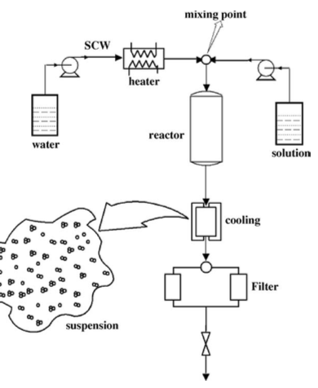
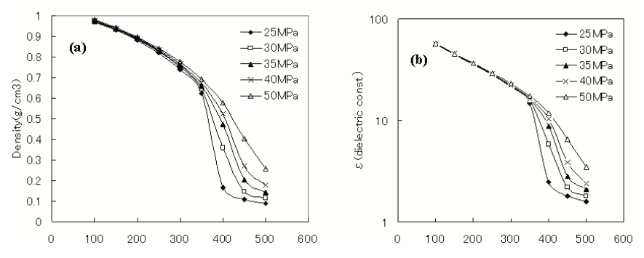
Supercritical hydrothermal synthesis
374 C и 220 атм

Slide 26
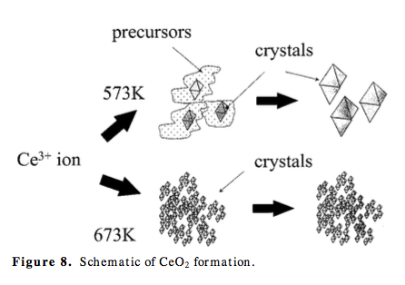
Supercritical hydrothermal synthesis

Slide 27
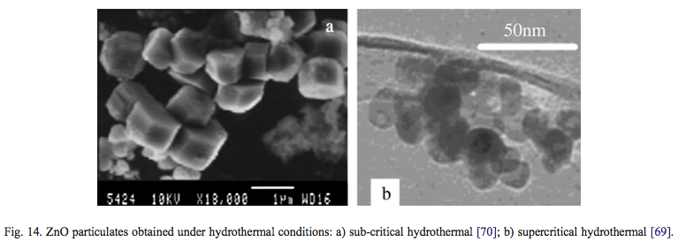
Supercritical hydrothermal synthesis
Сенсоры, солнечные батареи, в биомедицине для анализа связывания белков/пептидов
Антибактериалные агенты, защита от солнечного излучения в косметологии
Катализаторы, газовые сенсоры, адсорбенты ультрафиолета, защита клетов от образования свободных радикалов

Slide 28
Supercritical hydrothermal synthesis

Slide 29
Supercritical hydrothermal synthesis

